Slide 1
Data Transfer and Addressing

Slide 2
Contents
Segmented Memory Model
Data Transfer
Data Declaration
Addressing Modes
Direct
Indirect

Slide 3
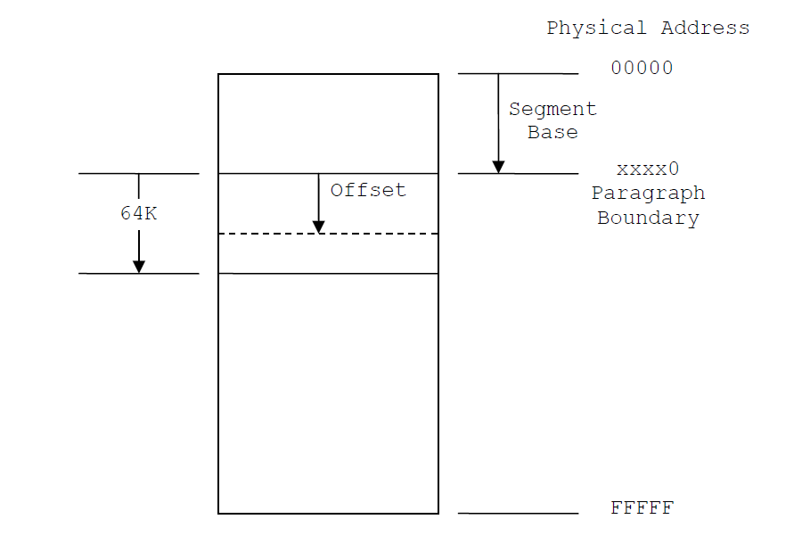
Segmented Memory Model

Slide 4
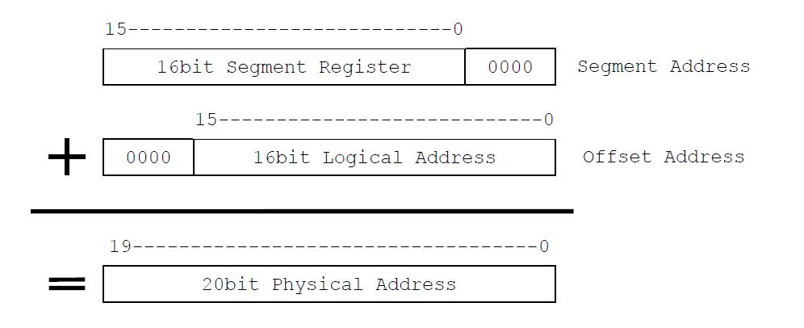
Logical to Physical Address

Slide 5
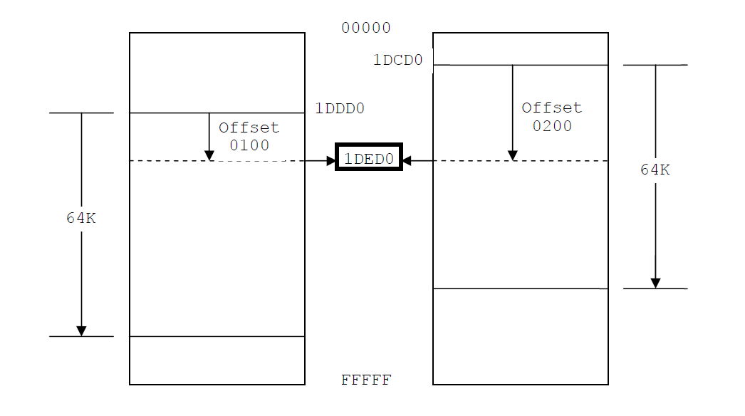

Slide 6
Data Transfer
The MOV instruction copies data from a source operand to a destination operand.
Known as a data transfer instruction, it is used in virtually every program.
Its basic format shows that the first operand is the destination and the second operand is the source:
MOV destination,source
It is equivalent to destination= source; in any high level language like in java or C++

Slide 7
Rules for MOV instruction
MOV is very flexible in its use of operands, as long as the following rules are observed:
Both operands must be the same size.
Both operands cannot be memory operands.
The instruction pointer register (IP) cannot be a destination operand.

Slide 8
MOV instruction formats
Here is a list of the standard MOV instruction formats:
MOV register, register
MOV register, immediate operand
MOV memory, register
MOV register, memory
MOV memory, immediate operand

Slide 9
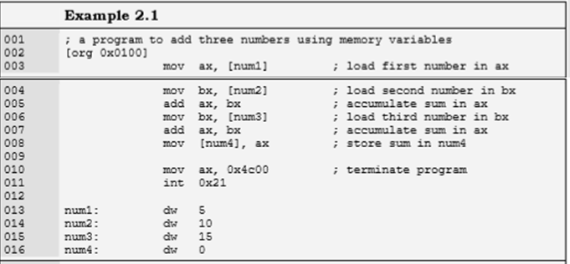
Direct Addressing

Slide 10
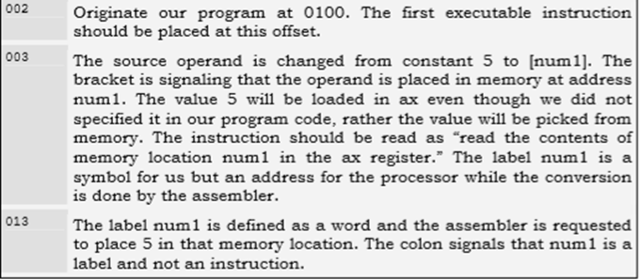

Slide 11
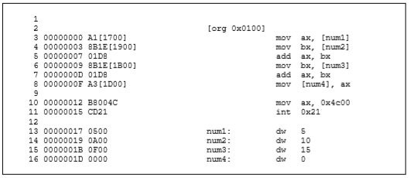
Listing file
The first instruction of our program has changed from B80500 to A11700.
The opcode B8 is used to move constants into AX, while the opcode A1 is used when moving data into AX from memory.
The immediate operand to our new instruction is 1700 or as a word 0017 (23 decimal) and from the bottom of the listing file we can observe that this is the offset of num1.
The assembler has calculated the offset of num1 and used it to replace references to num1 in the whole program. Also the value 0500 can be seen at offset 0017 in the file.
We can say contents of memory location 0017 are 0005 as a word. Similarly num2, num3, and num4 are placed at 0019, 001B, and 001D addresses.
When the program is loaded in the debugger, it is loaded at offset 0100, which displaces all memory accesses in our program. The instruction A11700 is changed to A11701 meaning that our variable is now placed at 0117 offset.
The instruction is shown as mov ax, [0117]. Also the data window can be used to verify that offset 0117 contains the number 0005.

Slide 12
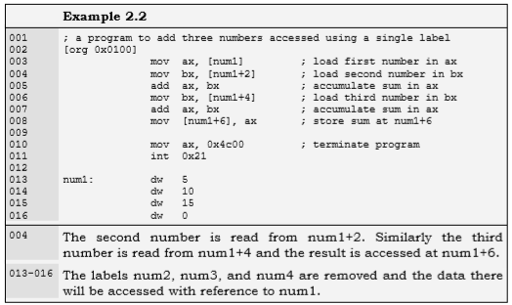

Slide 13
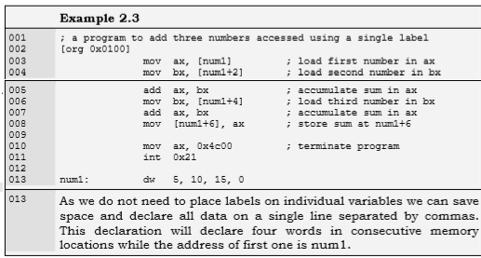

Slide 14
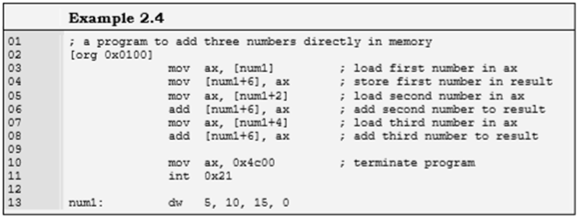

Slide 15
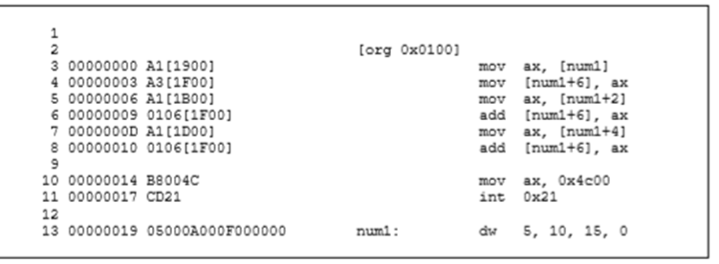

Slide 16
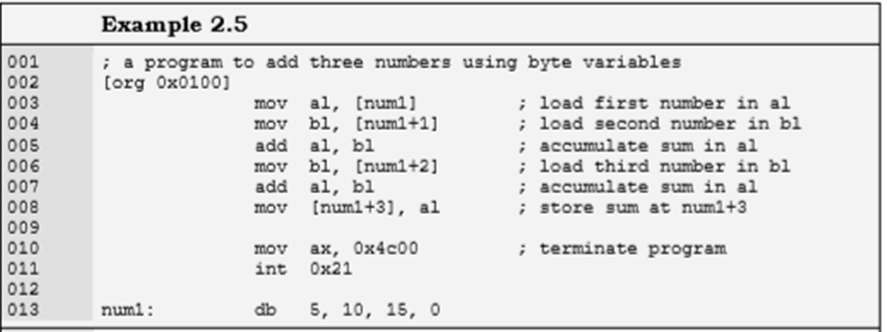
Size Mismatch Errors

Slide 17
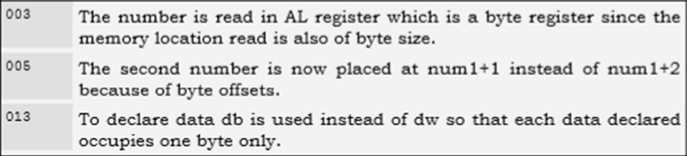

Slide 18
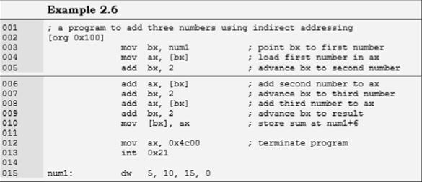
Register Indirect Addressing

Slide 19
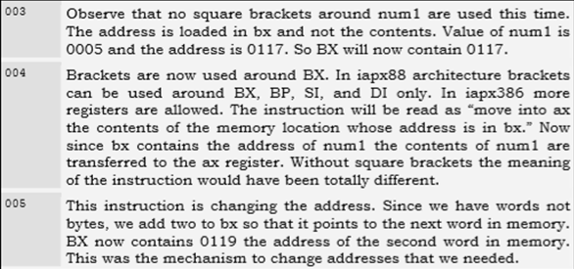

Slide 20
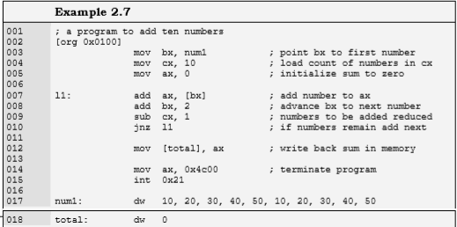

Slide 21
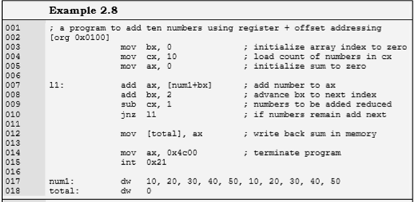
Register Indirect + Offset Addressing

Slide 22
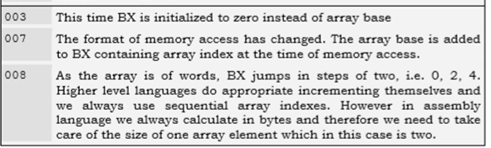

Slide 23
ADDRESSING MODES SUMMARY
Direct
Direct + offset
Indirect
Based Register Indirect (e.g. [BX] or [BP])
Index Register Indirect (e.g. [DI] or [SI])
Based Register Indirect + offset (e.g. [BX+100] or [BP+200])
Index Register Indirect +offset (e.g. [SI+100] or [DI+200])
Base + index (e.g. [BX+SI])
Base + index + offset (e.g. [BX+SI+300])
Things that are not allowed:
Base register + base register (e.g [BX+BP])
Index register + index register (e.g. [SI+DI])
Base – index (e.g. [BX-SI])
Part of register cannot be used to access memory address (e.g [BH] or [BL])

Slide 24
Important thing to remember
Programmer has a full control of memory.
If you write any (valid) 16 bit address in square brackets you will be able to access it , either its in form of label/registers +/- offset or simple constant number.
It is up to you to access it carefully without creating logical errors

Slide 25
Reading
BH 2.1, 2.2, 2.3, 2.4, 2.5

